Slide 1
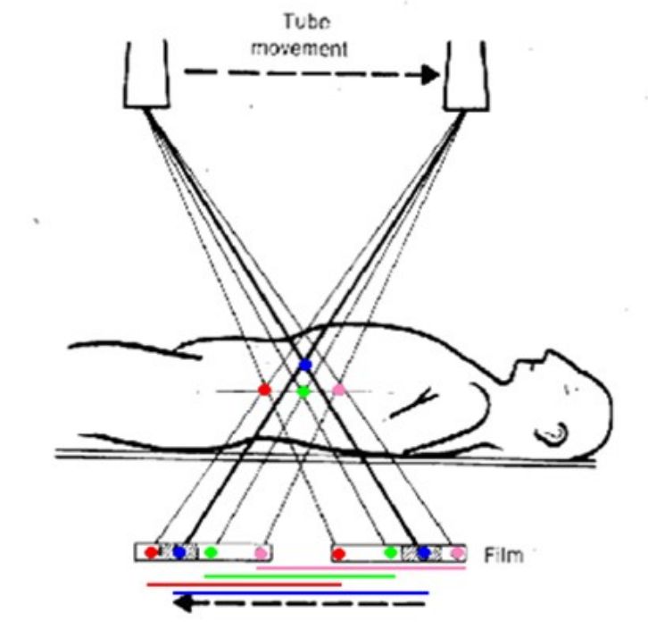
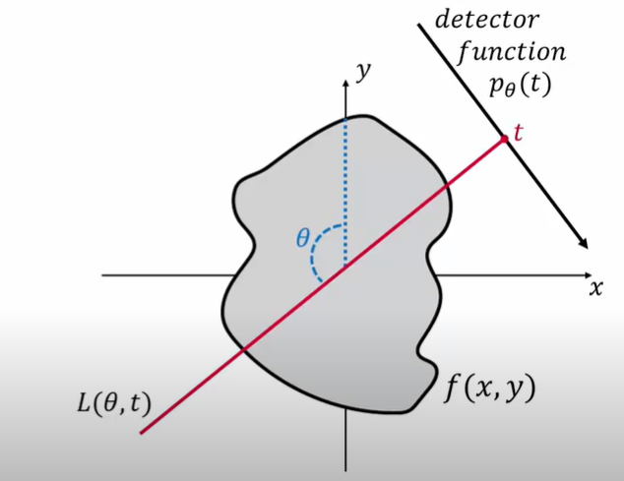
Computerized Tomography
Properties of the Radon Transform
Ariel Fuxman, Gilad Zusman & Tamar Entin

Slide 2


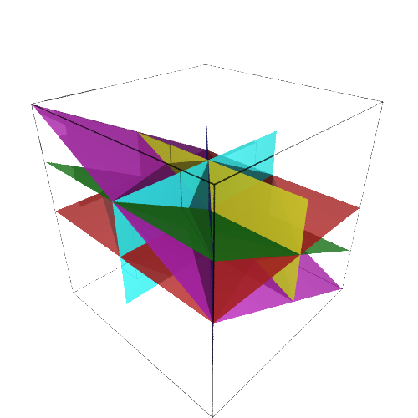
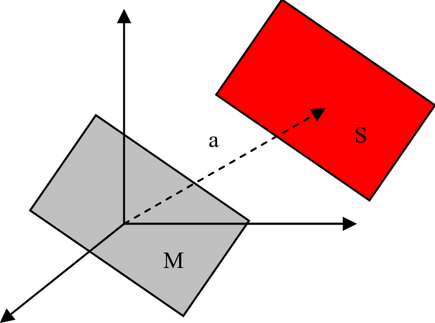
The Definition of the Radon Transform

Slide 3
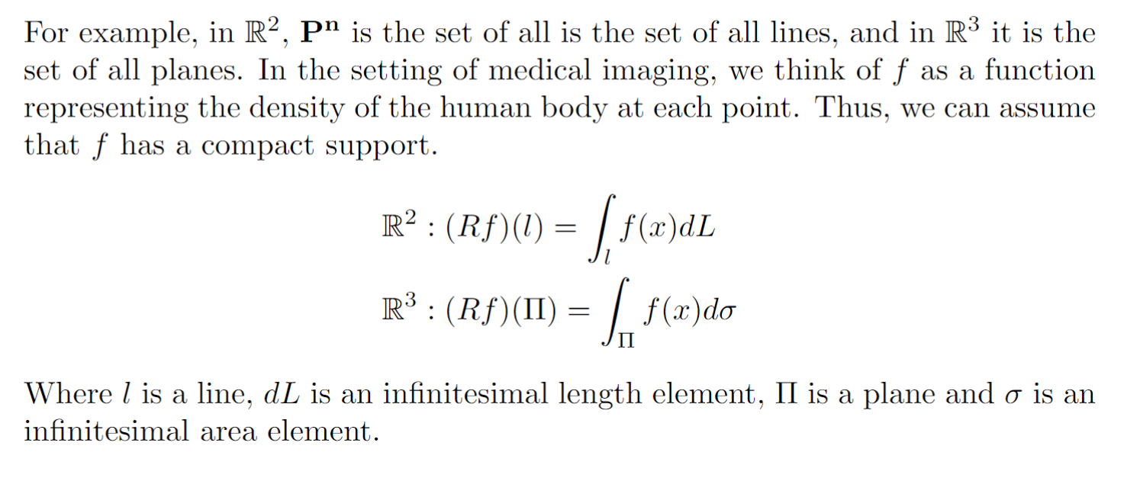
The Definition of the Radon Transform

Slide 4

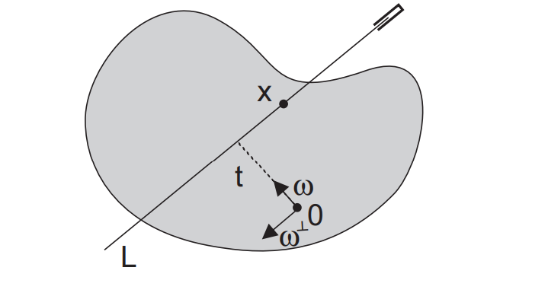
Parameterization

Slide 5
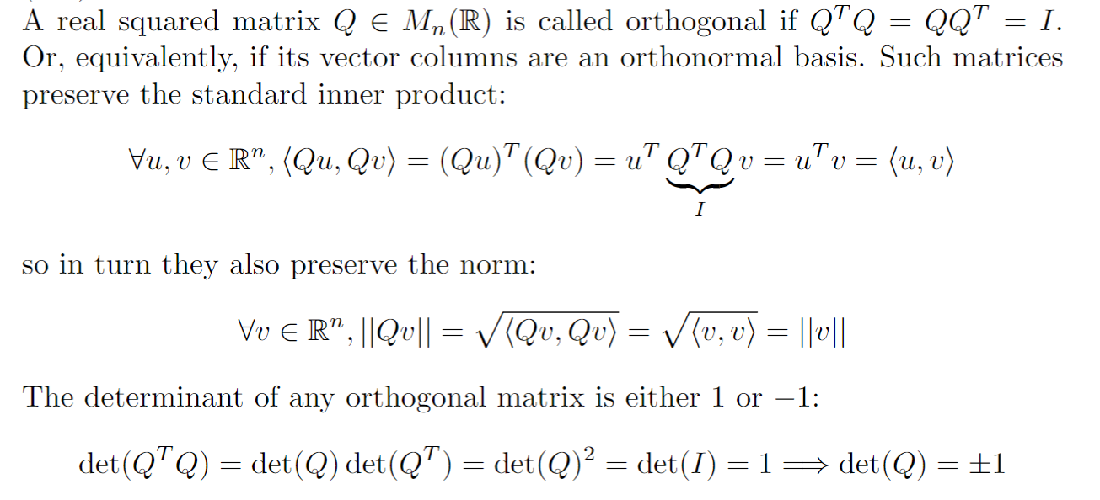
Orthogonal Matrices

Slide 6

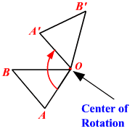
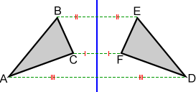
Geometric Meaning of Orthogonal Matrices

Slide 7
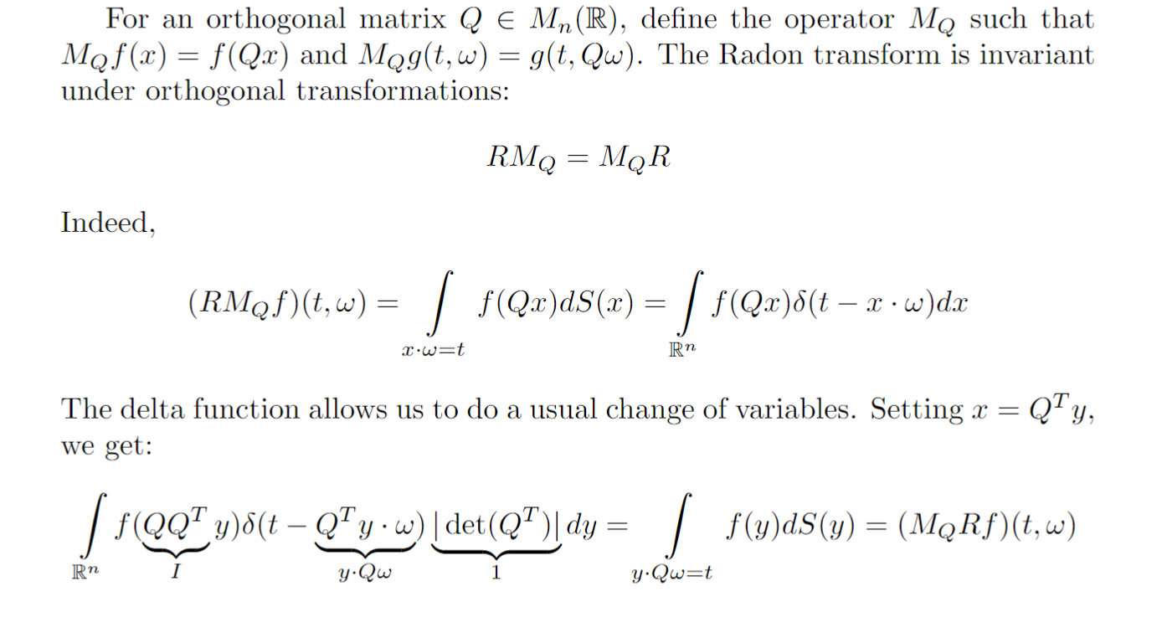
Invariance Under Orthogonal Transformations

Slide 8
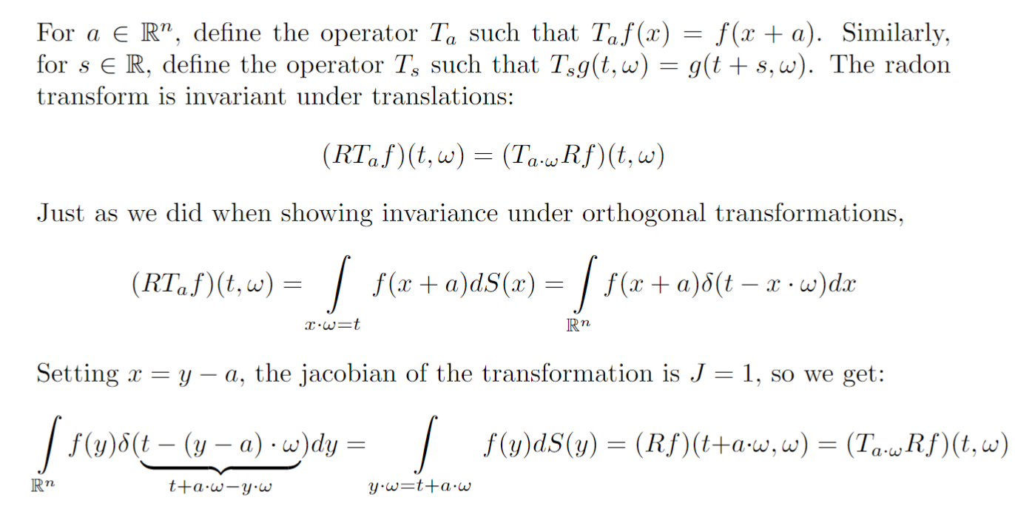
Invariance Under Translation

Slide 9
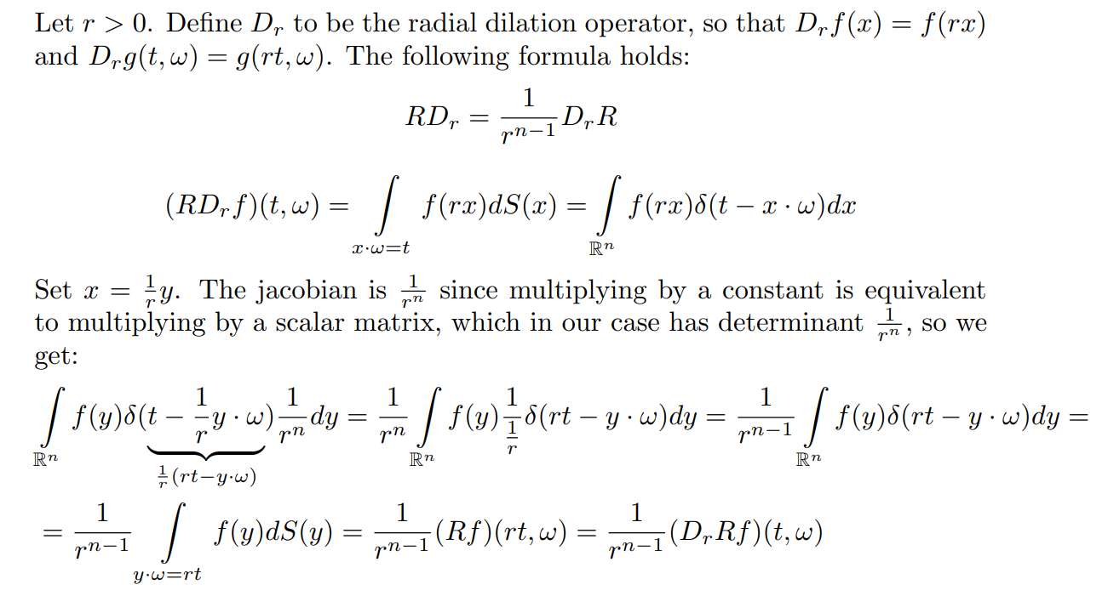
Quasi-Invariance Under Dilations

Slide 10
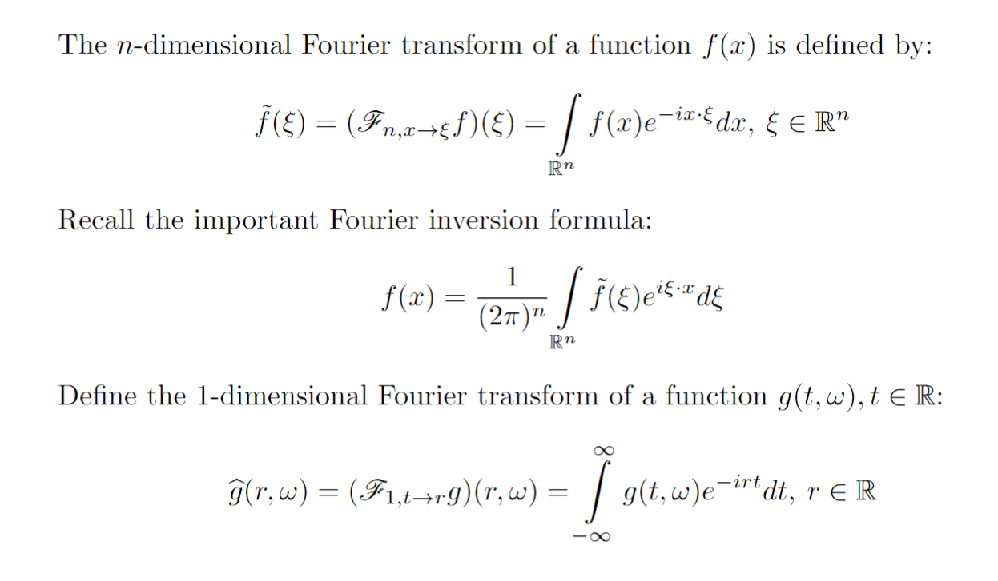
The Fourier Transform

Slide 11
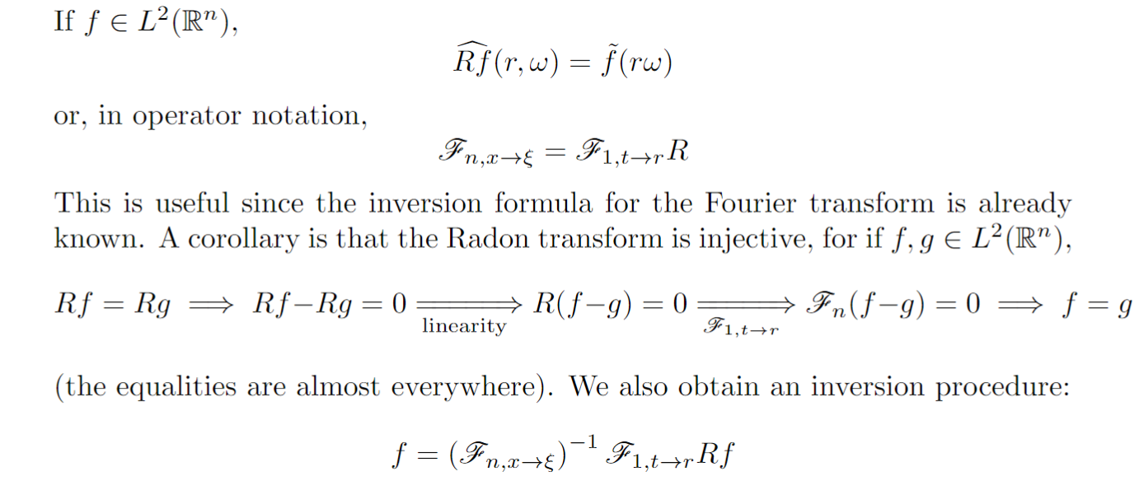
Projection Slice Formula

Slide 12
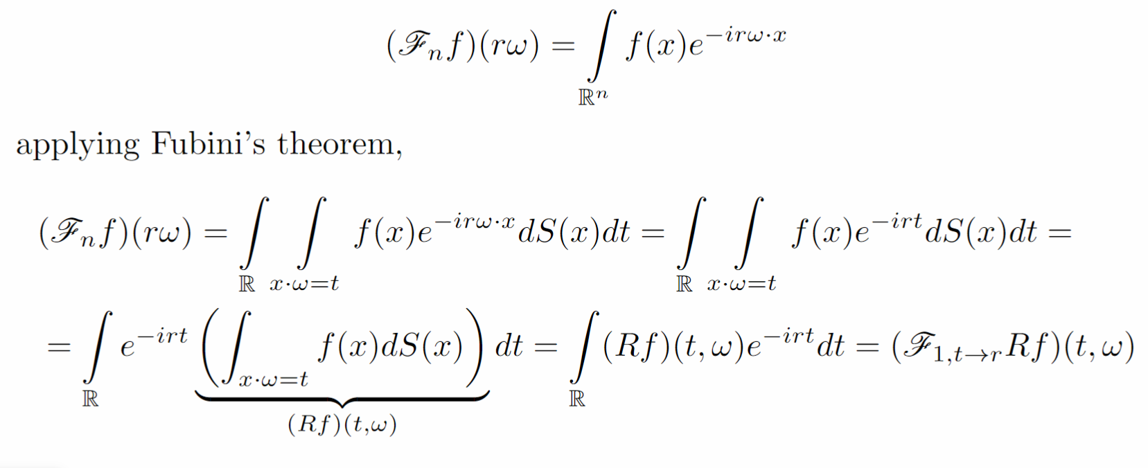
Derivation of the Formula

